Slide 1



Artificial Intelligence
ARTIFICIAL INTELLIGENCE PRESENTATION
What we learned from this course

Slide 2


Welcome to the AI World
Artificial Intelligence is the simulation of human intelligence in machines. The goal is to create agents that can perceive , reason and act effectively in Various environments.
AI Agents
An AI agent interacts with its environment through sensors and actuators,enabling it to perform tasks based on perceived information.

Slide 3


Problem Solving
State-Space Search
Well-Defined Problems
State space search is an algorithmic process of exploring a set of all possible states and transitions in a problem domain to find a solution path from an initial state to a goal state.
Clear Parameters including initial states, goal state, and operators aid AI in systematically navigating through potential solutions.

Slide 4
Uninformed Search
BFS
DFS
DLS
Breadth-first search explores graph layers systematically, ensuring level-order traversal.
Efficient algorithm exploring tree/graph by visiting nodes deeply.
Depth-limited search restricts exploration depth to prevent infinite recursion.

Slide 5
Informed Search
A* Search
Best First Search
Best first search prioritizes exploration based on node evaluation.
Efficiently finds shortest path in graph using heuristics.

Slide 6
Advanced Search
MiniMax
Alpha-Beta
AO*
AO* search is a graph-based algorithm for optimal pathfinding.
Minimax algorithm optimizes decision-making in competitive situations.
Alpha-beta pruning optimizes decision-making in game trees efficiently.

Slide 7
Optimization Algorithm
0/1 Knapsack
Branch and Bound
Branch and bound algorithm efficiently solves optimization problems by systematically exploring branches.
The 0/1 knapsack algorithm optimizes item selection based on weight and value constraints.

Slide 8



Constraint Satisfaction Problem
A Constraint Satisfaction Problem (CSP) is a framework aimed at finding solutions that meet specified constraints. It consists of variables, their possible values (domains), and constraints limiting value combinations. The goal is to assign values fulfilling all constraints, useful in AI, operations research, and computer science for efficient scheduling and planning.
N-Queen Problem
place queens on chessboard without attacking.
Job Scheduling
Efficiently allocating tasks to resources for optimized productivity and efficiency.
CryptoArithmetic Puzzles
Crypto arithmetic puzzles are numerical brainteasers using letters as digits.

Slide 9
Local Consistency
Local consistency in constraint satisfaction problems (CSP) ensures each variable's value aligns with its neighbors' values. It includes node, arc, and path consistency, reducing search space by eliminating early inconsistencies.
Node Consistency
Path Consistency
ARC Consistency
Global Consistency

Slide 10
Knowledge Representation Reasoning
Logic
Rules
Semantic Netword
Frame
Script
Independent Law
Cumulative Law
Associative Law
De-Morgans Law

Slide 11
Learning Paradigms
Supervised
Unsupervised
Reinforcement
Supervised learning uses labeled data to train algorithms for predictions.
Unsupervised learning discovers patterns in data without labeled examples.
Reinforcement learning involves training agents through reward-based feedback.

Slide 12
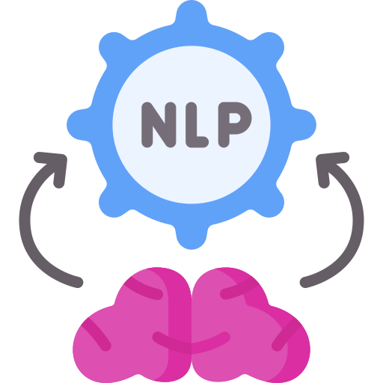

AI in Action
Robotics
Natural Language Processing

Slide 13


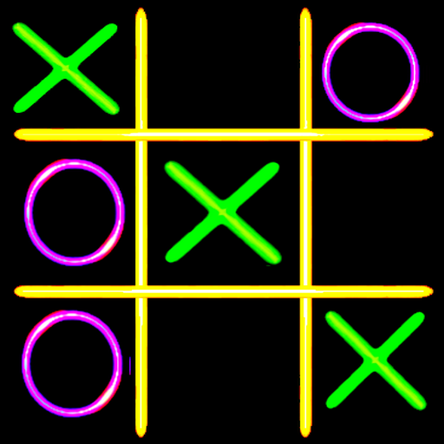
AI Based Games
AI-driven chess game utilizes minimax algorithm for challenging human opponents.
Minimax algorithm guarantees a strategic, unbeatable Human vs AI Tic-Tac-Toe.
AI-based maze solver game utilizes BFS for efficient pathfinding.

Slide 14
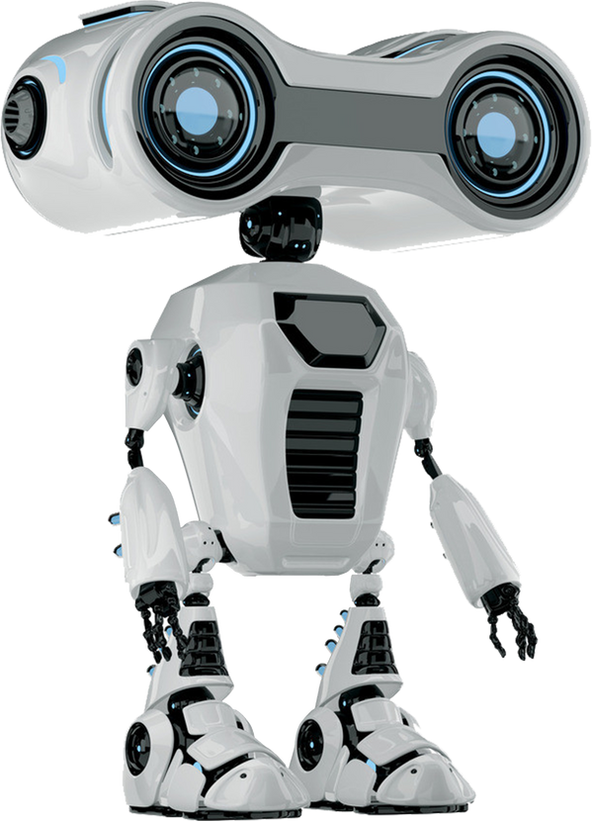
Thank You
FOR YOUR ATTENTION

